Slide 1
Our Mission
Lafayette L.O.S.T., a 501(c)(3) charitable organization, is dedicated to raising and donating monies to deserving persons in the oilfield that are in need of financial help and to other local needful charities. Our goal is to raise these monies through a series of Sporting Clays Tournaments, culminating in our Annual Championship Shoot, where adult men and women employed in the area oilfield and related service companies, can meet with fellowship in friendly competition.

Slide 2
  2021 Board Members
  Scottie Richard President
  Bill Pool Vice President
  Doug Begley Secretary
  Pat Begley Treasurer
  Mickey Faulkinberry Chairman Emeritus
  Jimmy Poche’ Recipient Chairperson
  Tracie Ross Social Media Director
  Dwayne Truesdell Board Member
  Mike Latiolais Board Member
  Mary Johnson Board Member
  Troy Roberie Board Member
  Jean Bagwell Board Member
  Tony Morrow Legal Counsel
  2021 Committee Members
  Please see Board Member if you are interested.

Slide 3
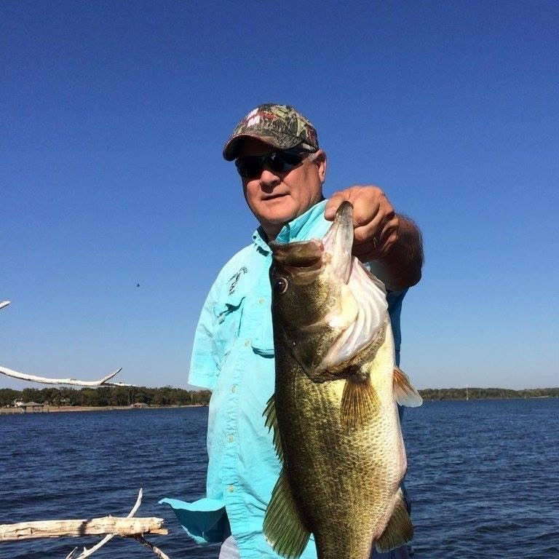
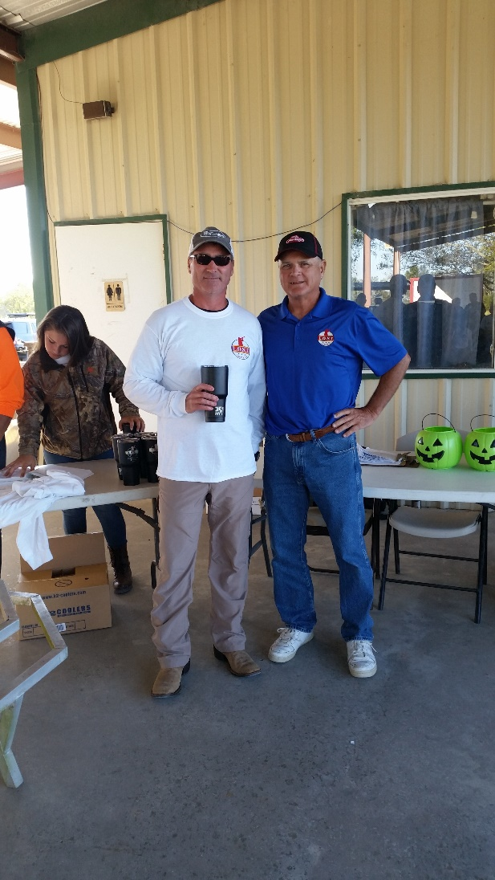
Royce Bagwell 2021 Recipient

Slide 4
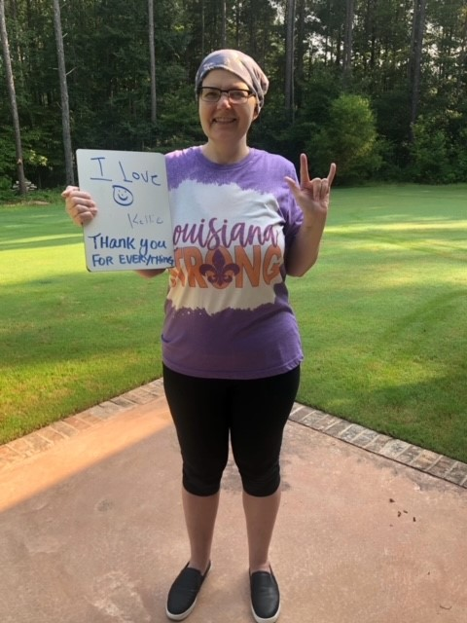
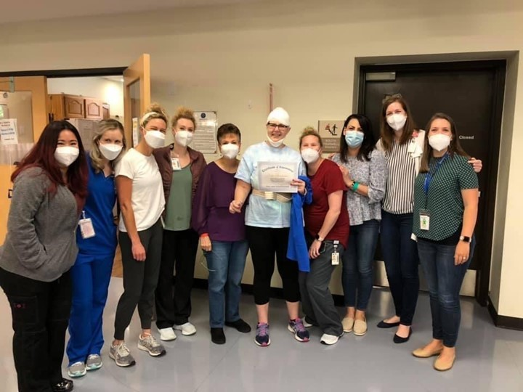
Kellie Boudreaux 2021 Recipient

Slide 5
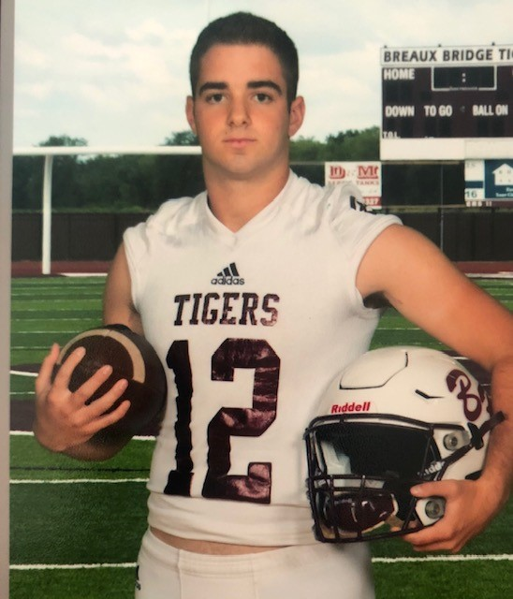
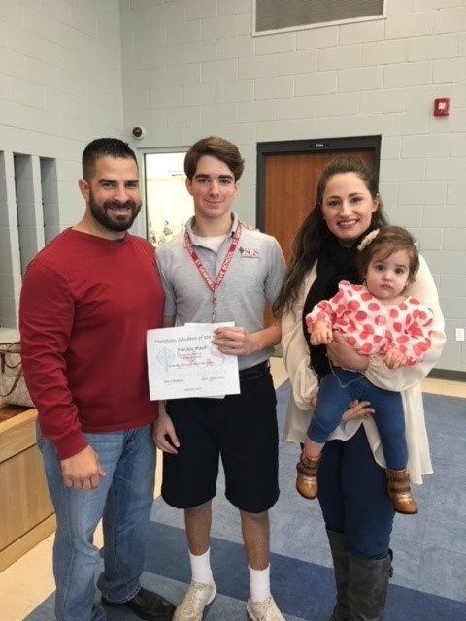
Tanner Reed 2021 Recipient

Slide 6
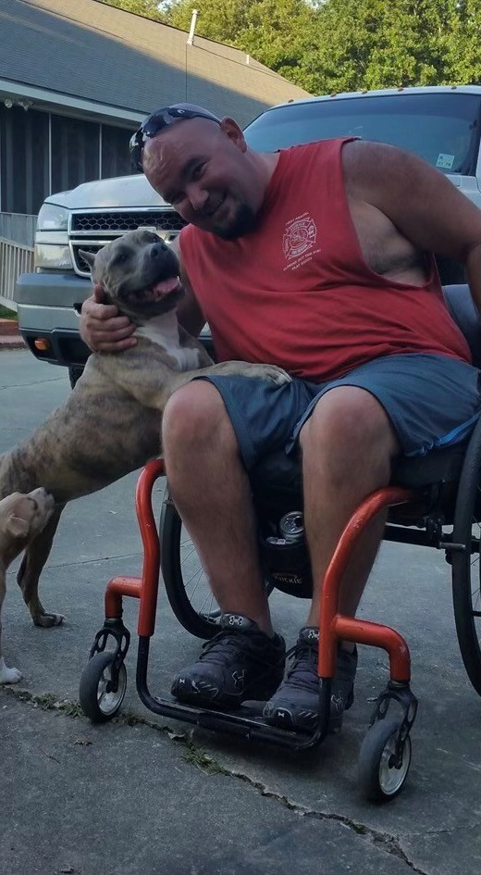
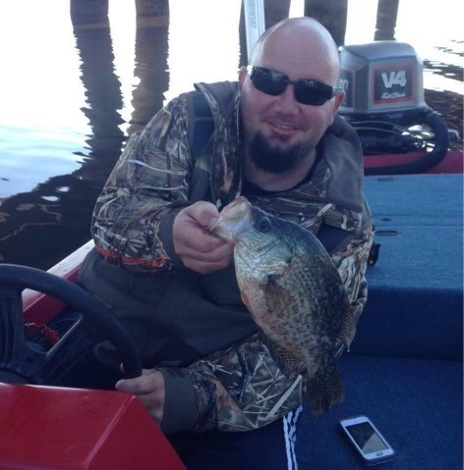
Damion Royer 2021 Recipient

Slide 7
Sponsorship Levels
Diamond $5,000.00
Platinum $3,000.00
Gold $2,000.00
Silver $1,000.00
Bronze $500.00
All monies from these sponsorships will be used directly for recipient donations. Sponsors will be recognized on website, slide show presentation during each shoot and tournament shirts given at championship.
Ask a Board Member how to become a sponsor today!

Slide 8


Diamond Sponsors $5000.00

Slide 9
Platinum Sponsors $3000.00

Slide 10

Gold Sponsors $2000.00
Doug & Pat Begley

Slide 11

Silver Sponsors $1000.00

Slide 12

Bronze Sponsors $500.00
Sid Lyons

Slide 13

Many Thanks To This Months Food & Drink Sponsors
Keith Talley

Slide 14
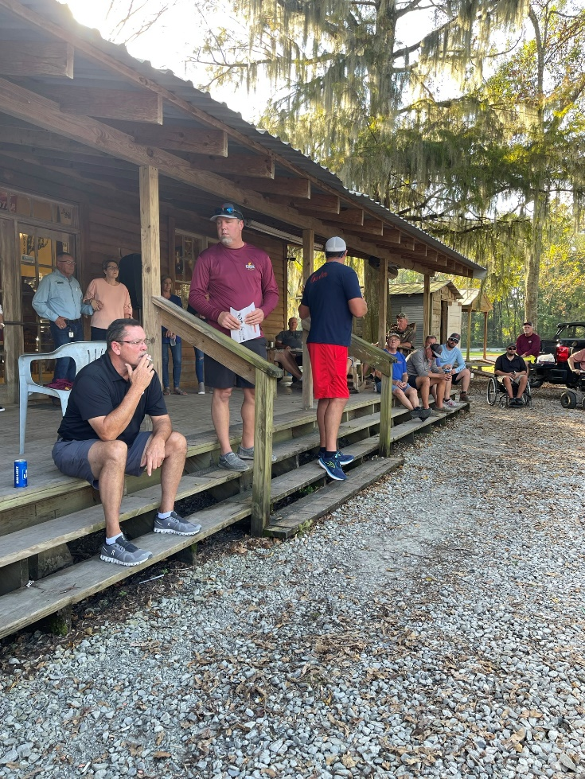
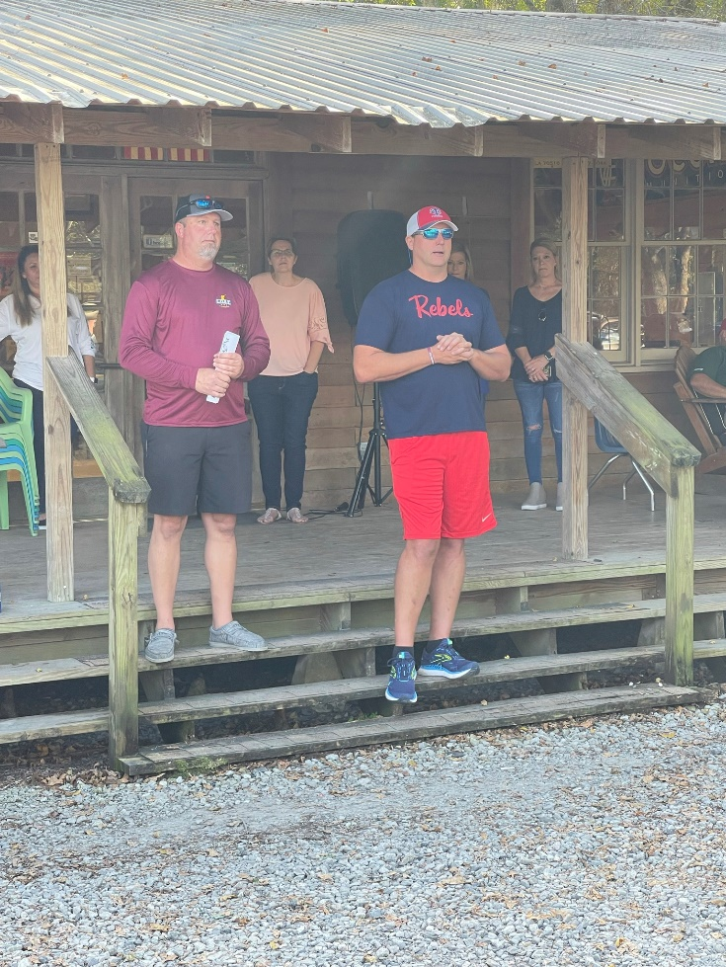

Slide 15
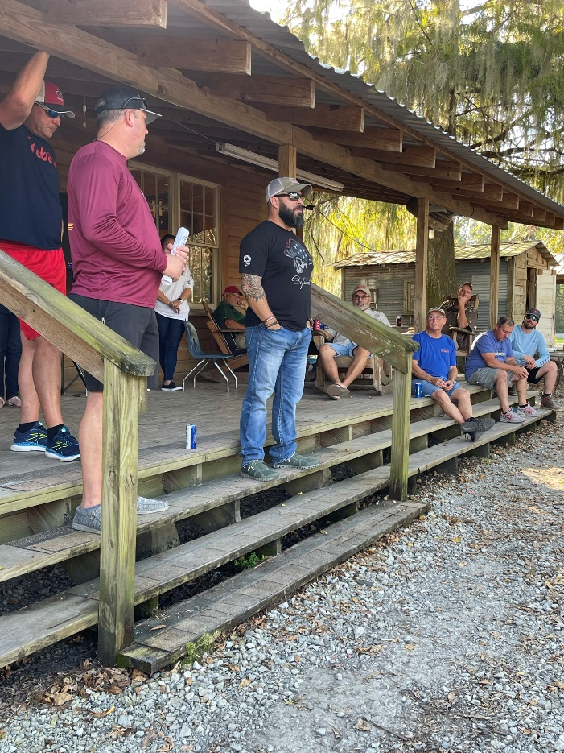
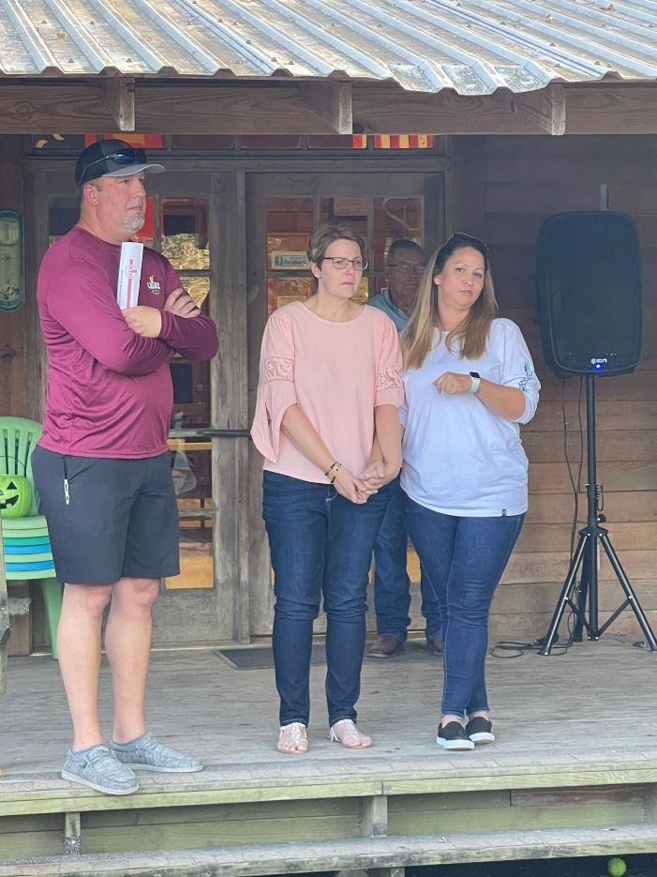

Slide 16
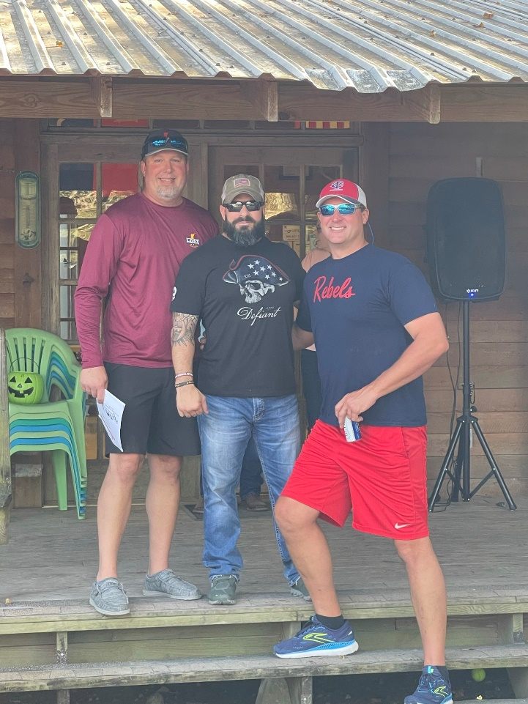
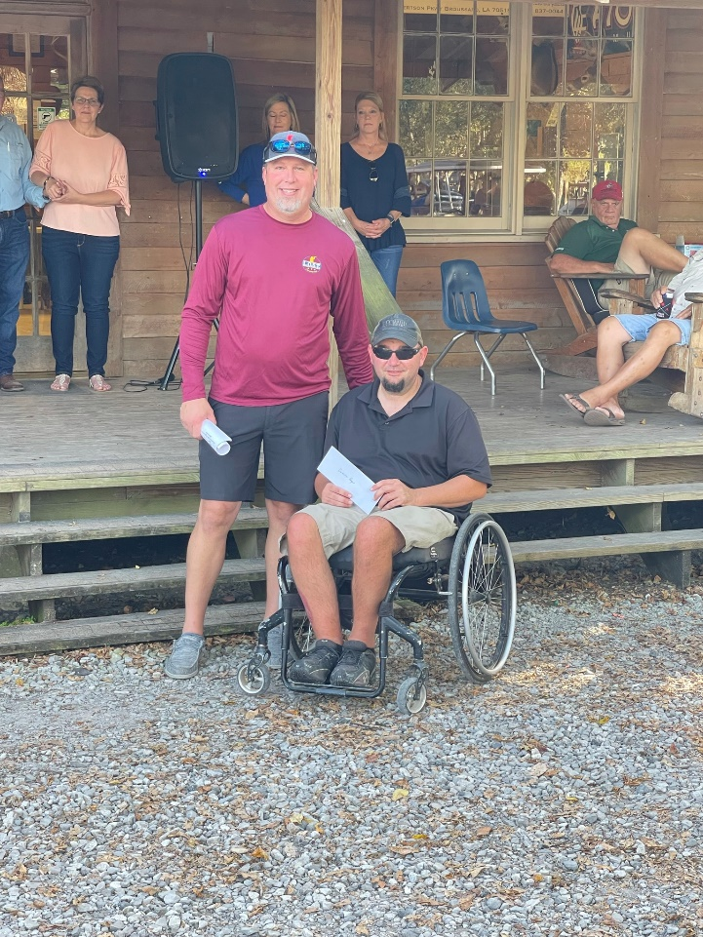

Slide 17
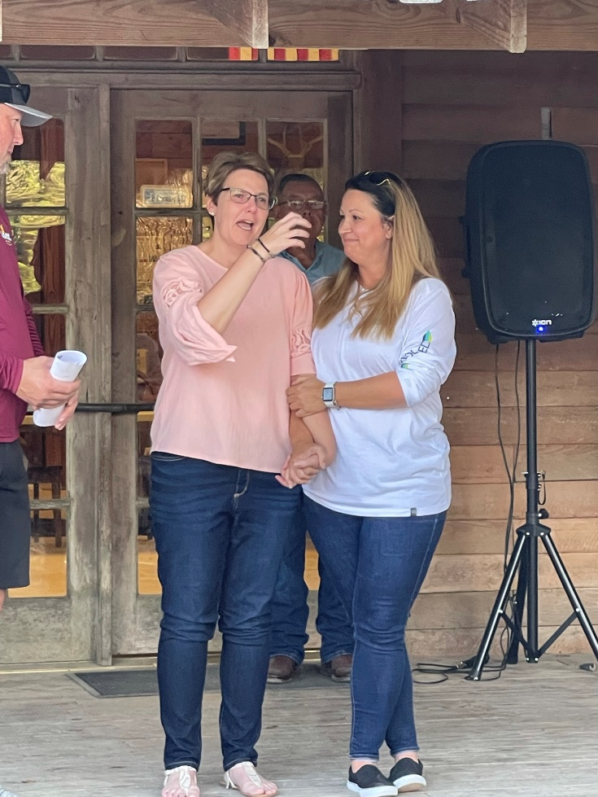
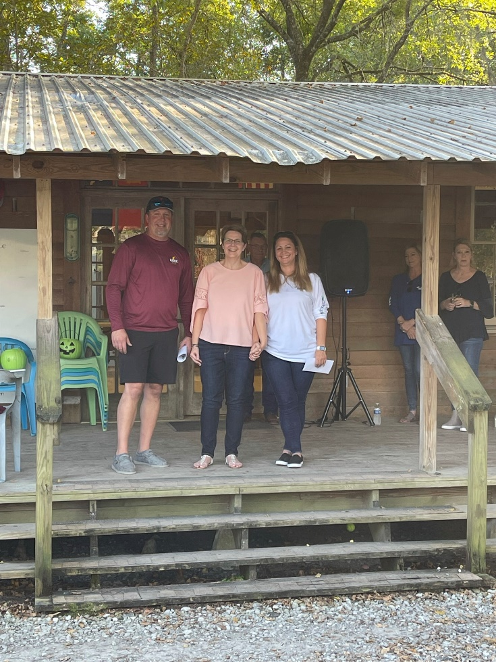

Slide 18
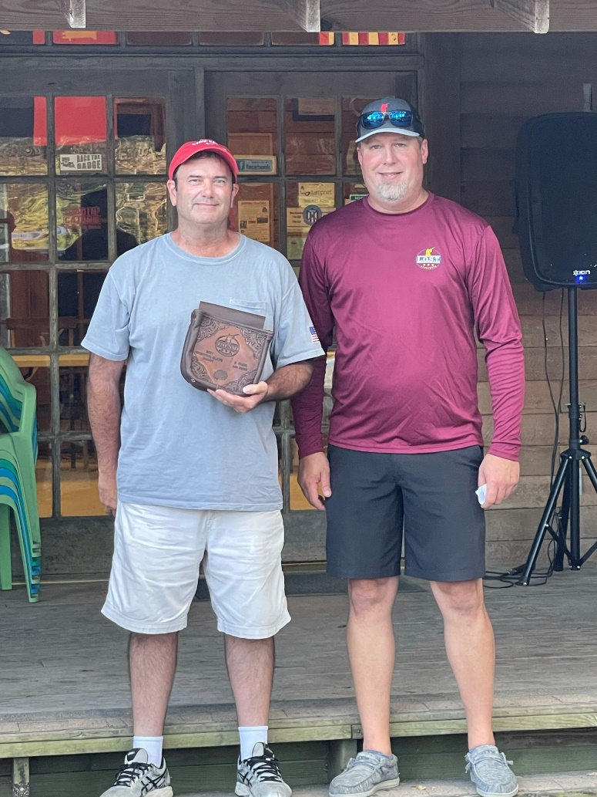
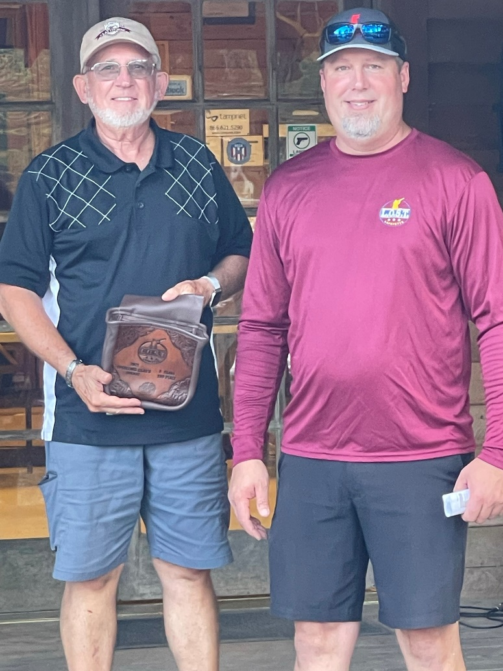

Slide 19
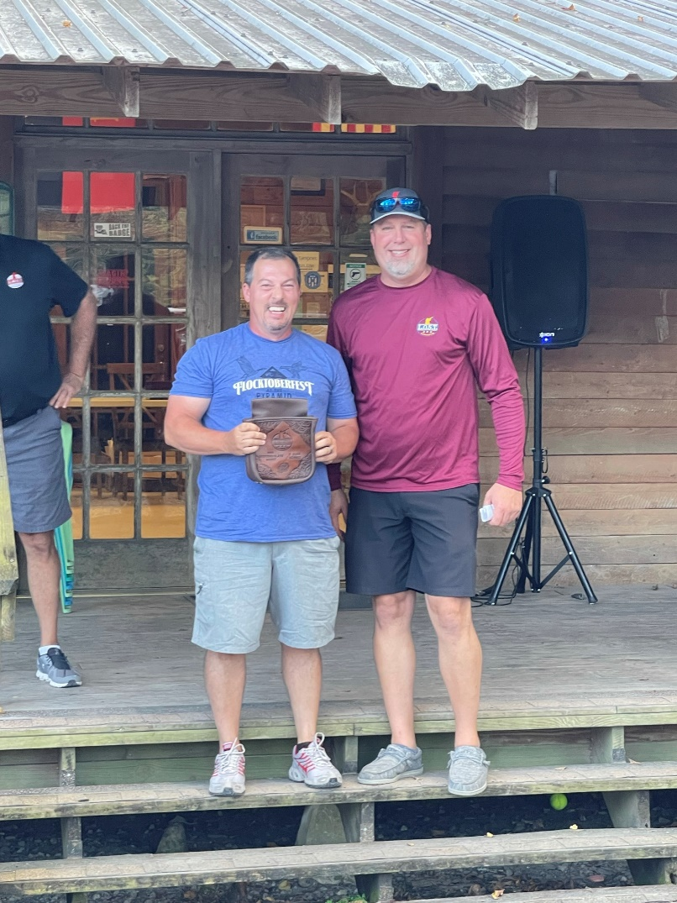
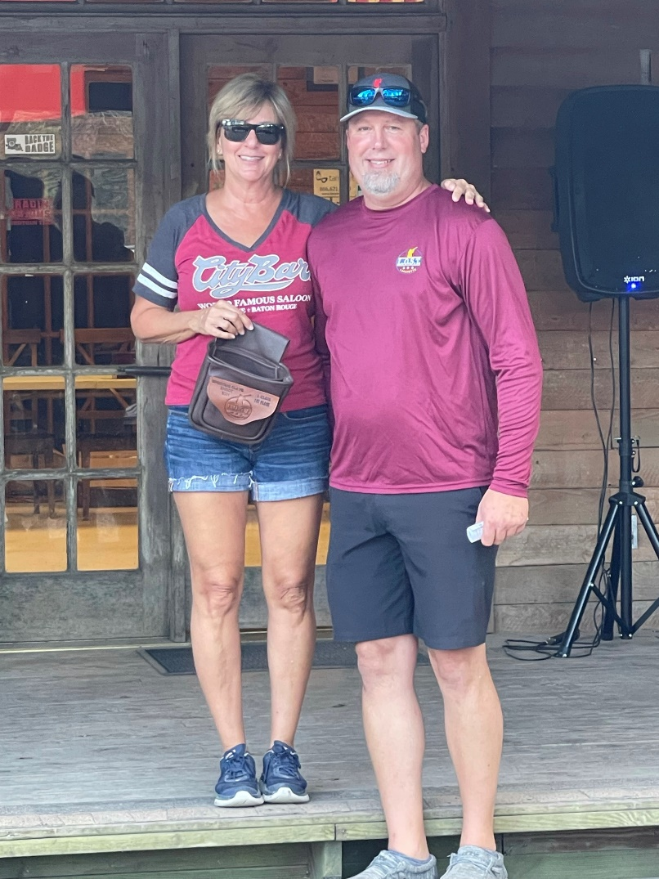

Slide 20
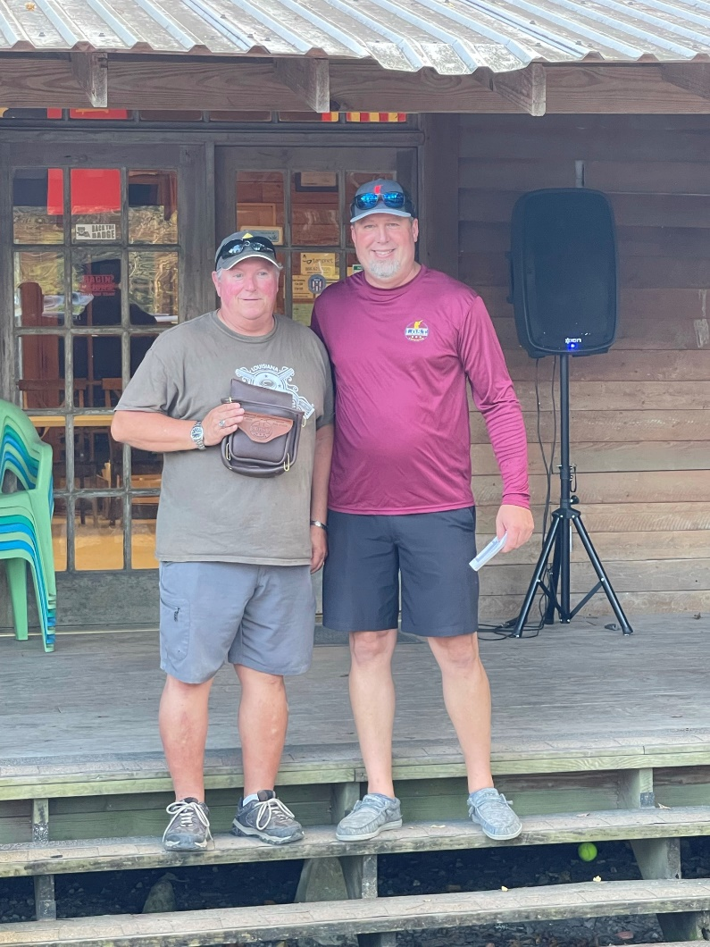
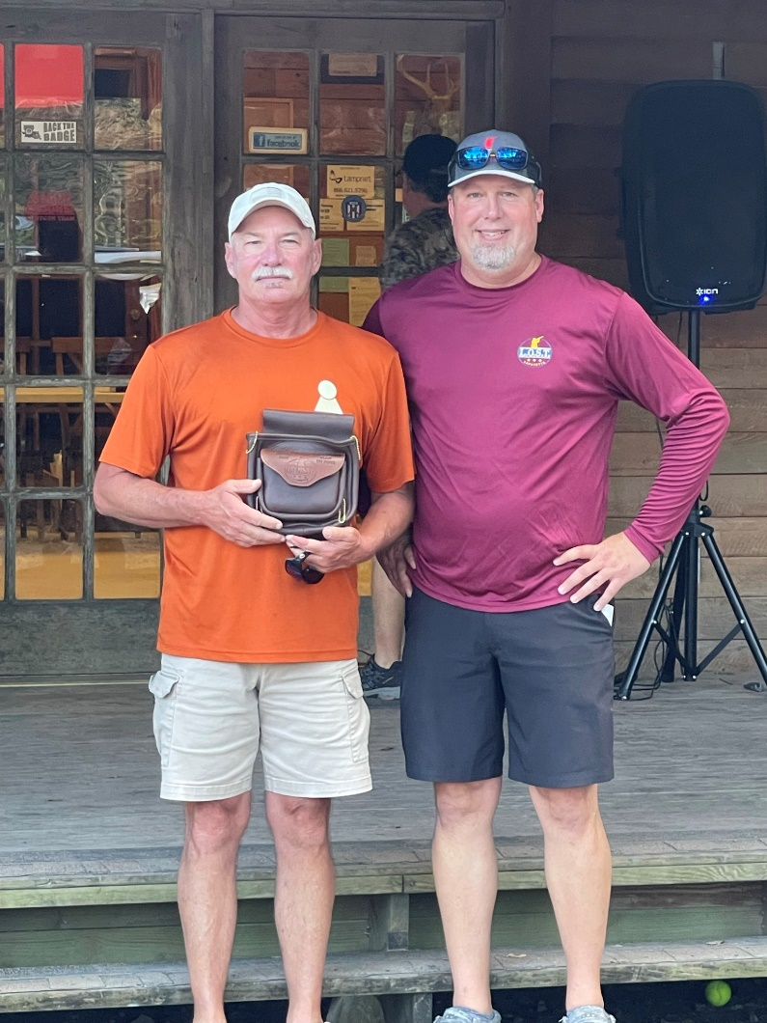

Slide 21
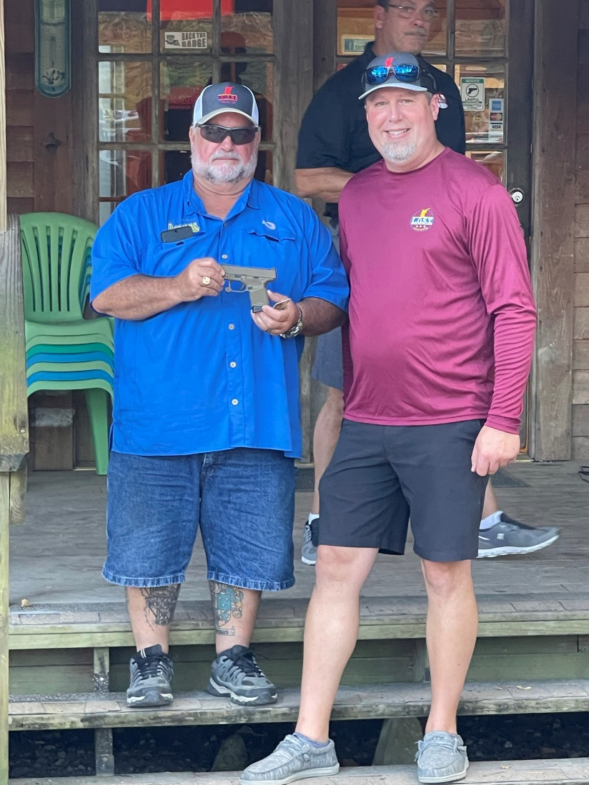
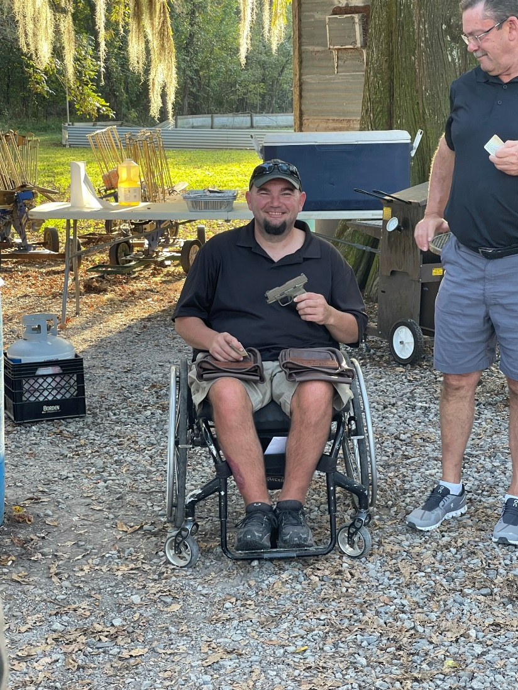

Slide 22
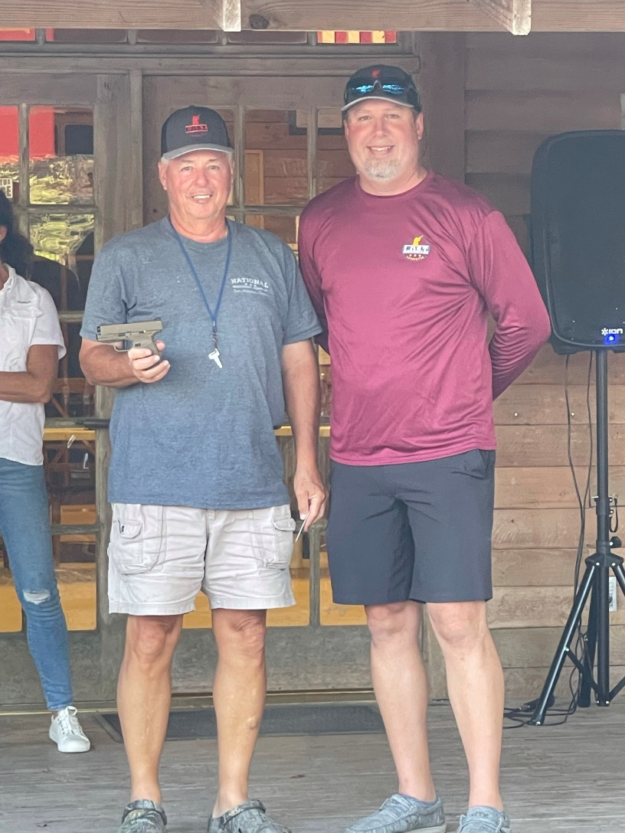
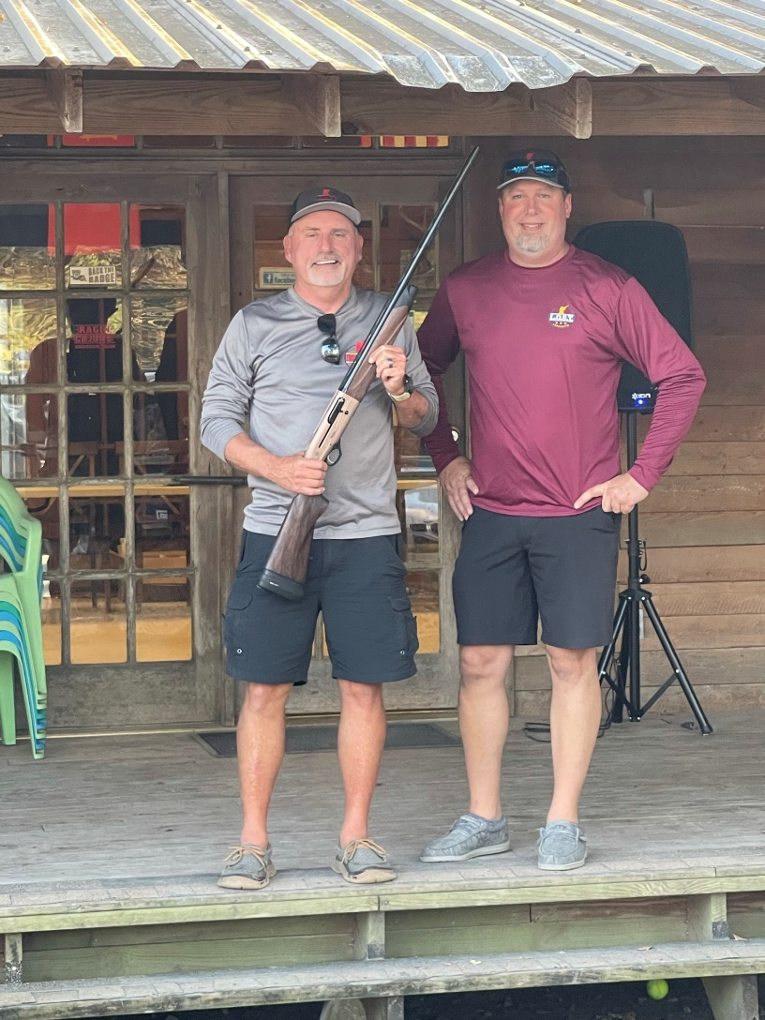

Slide 23
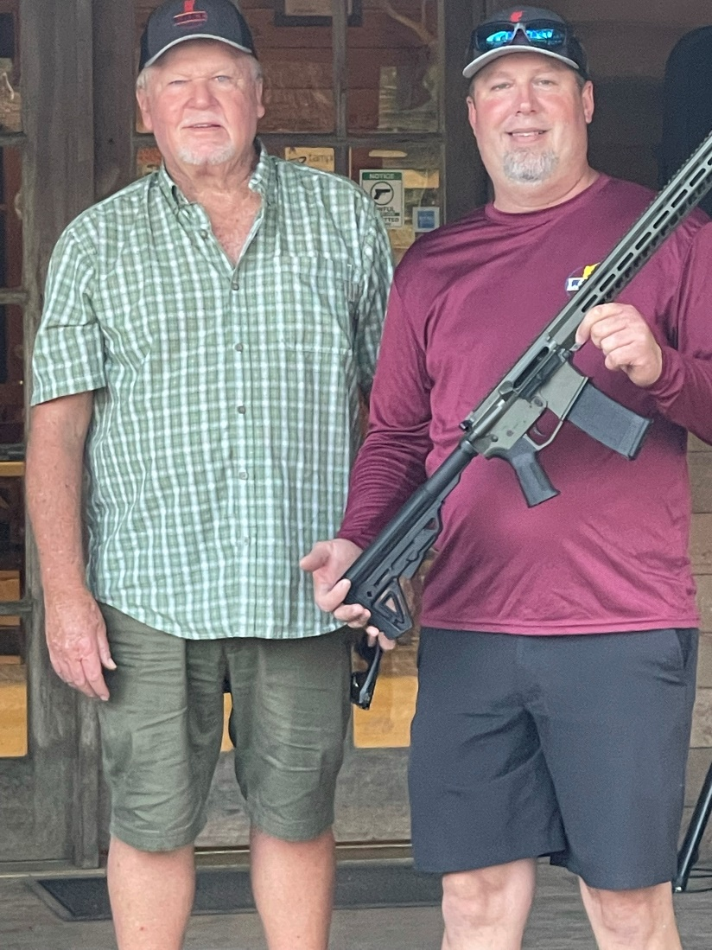
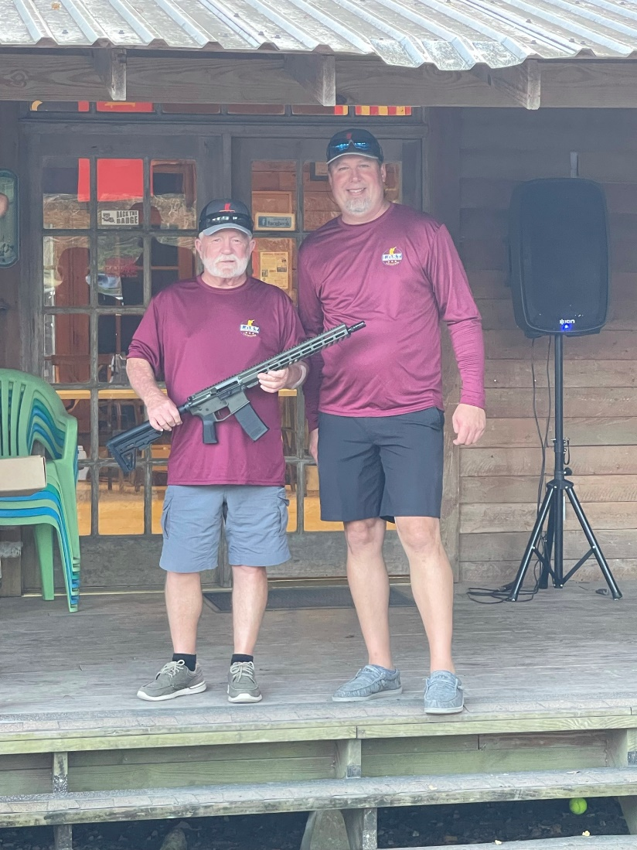

Slide 24
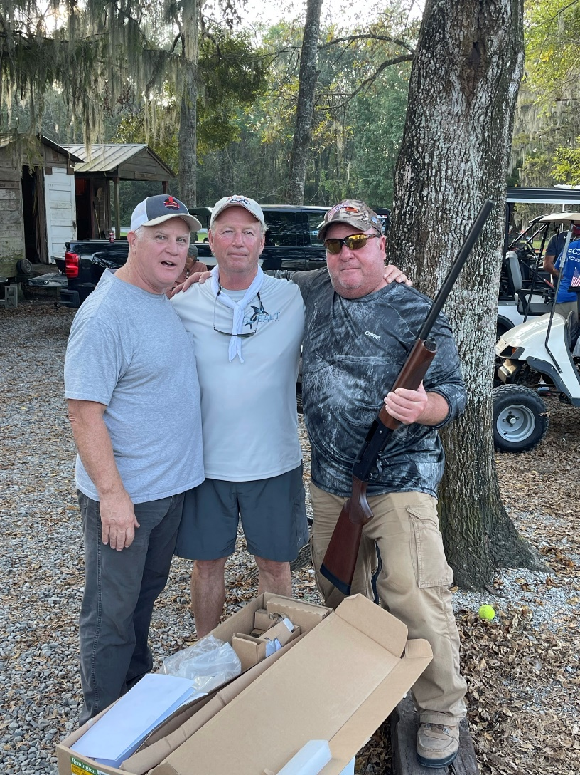
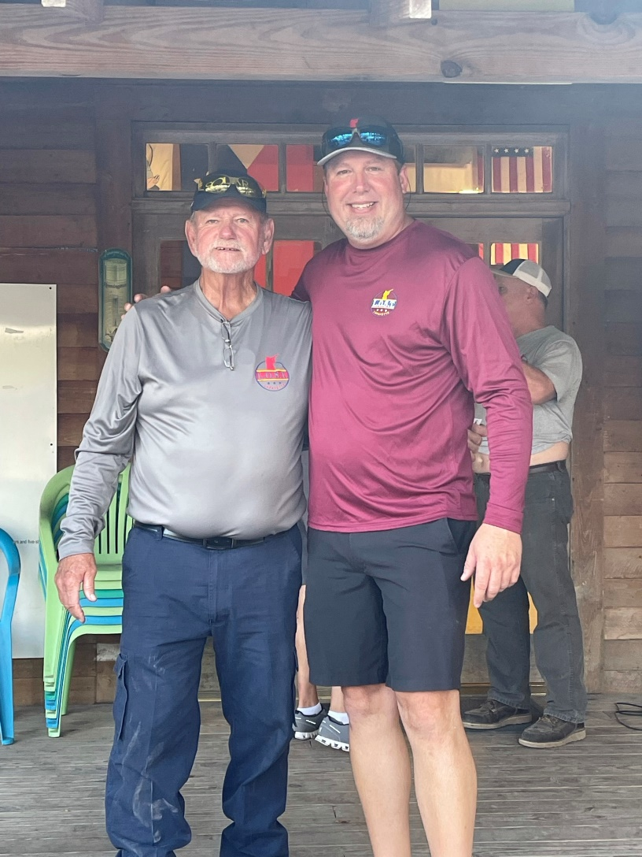

Slide 25
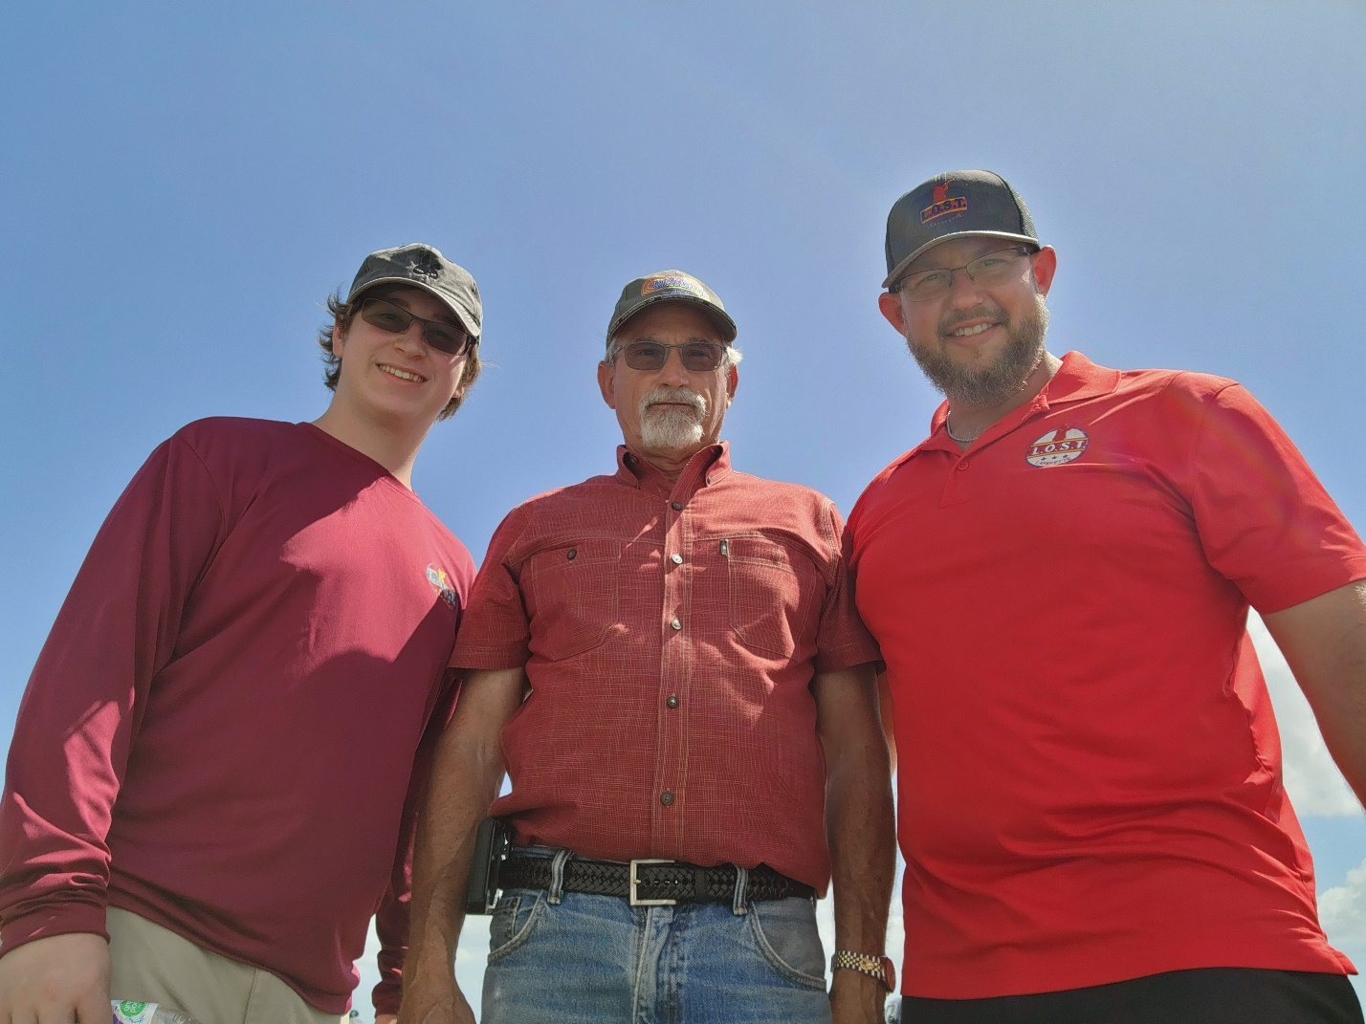

Slide 26
Current 50/50 RAFFLE POT
$370

Slide 27
2022 Events
Wilderness Gun Club 6-24-202
Wilderness GUN CLUB 7-22-2022 ed’s sporting goods 8-19-2022
Wilderness Gun Club 9-23-2022
2022 championship at ed’s Sporting Goods
10-14-2022

Slide 28
Follow us on Facebook, LOST Lafayette!

